Slide 1

HES-SO
Sierre, May 1st
Learning, Adapting, and Exploiting Word Embedding for
Text Analysis and Search
Navid Rekabsaz
navid.rekabsaz@idiap.ch
@navidrekabsaz

Slide 2
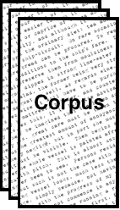


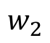
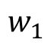
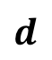
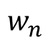
Word Embedding
$$d$$
$$w_{1}$$
$$w_{2}$$
Word Embedding Black-box
$$w_{n}$$

Slide 3
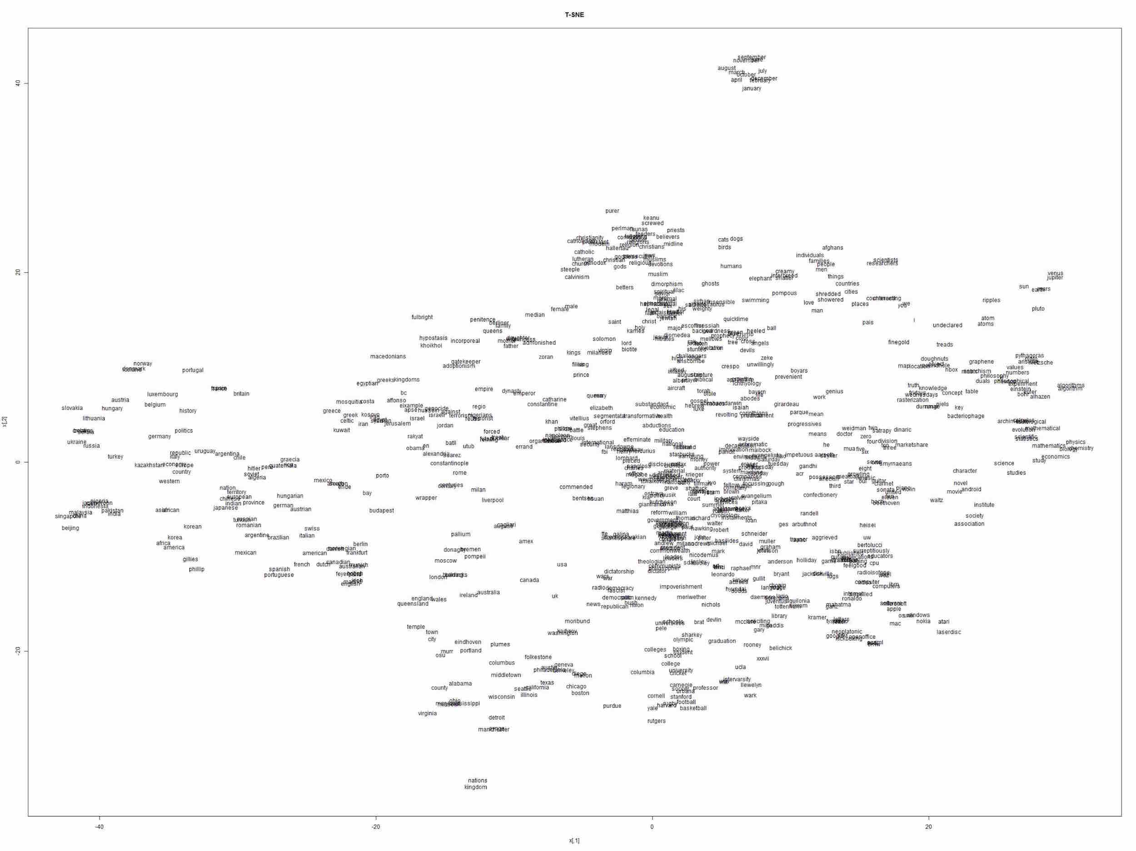
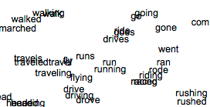

Slide 4
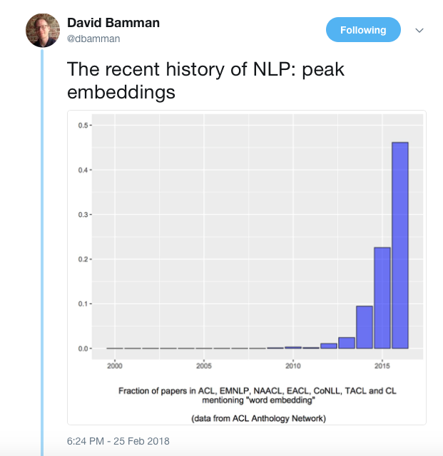

Slide 5
Ongoing Work …
Applications in Text Analysis
Financial Volatility Prediction
Gender Bias in Wikipedia
Word Embedding in IR
Generalized Translation Models
Uncertainty in Word Similarity
Threshold on Similarity
Adapting Word Similarity
Fusion of Word Embeddings
Multi-resource Word Representation Learning
Background
Explicit and Dense Word Representation
word2vec SkipGram Model

Slide 6
Ongoing Work …
Applications in Text Analysis
Financial Volatility Prediction
Gender Bias in Wikipedia
Word Embedding in IR
Generalized Translation Models
Uncertainty in Word Similarity
Threshold on Similarity
Adapting Word Similarity
Fusion of Word Embeddings
Multi-resource Word Representation Learning
Background
Explicit and Dense Word Representation
word2vec SkipGram Model

Slide 7
alcohol
drink
drunk
on the table
Tesgüino
make
out of corn
fermented
bottle of
Mexico
Nida[1975]

Slide 8
Dutch
drunk
pale
Heineken
brew
red star
bar
drink
green bottle
alcohol

Slide 9
Tesgüino ←→ Heineken
Algorithmic intuition:
Two words are related when they have similar context words

Slide 10
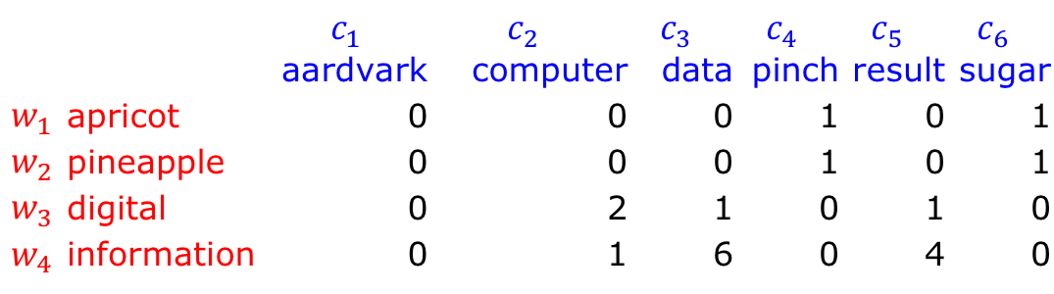
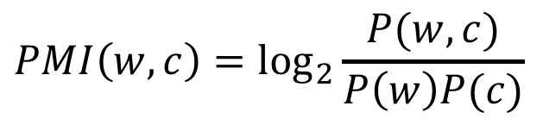
Word-Context Explicit Representation
Window context of 7 words
 |  | $$c_{1}$$ | $$c_{2}$$ | $$c_{3}$$ | $$c_{4}$$ | $$c_{5}$$ | $$c_{6}$$
 |  | aardvark | computer | data | pinch | result | sugar
$$w_{1}$$ | apricot | 0 | 0 | 0 | 1 | 0 | 1
$$w_{2}$$ | pineapple | 0 | 0 | 0 | 1 | 0 | 1
$$w_{3}$$ | digital | 0 | 2 | 1 | 0 | 1 | 0
$$w_{4}$$ | information | 0 | 1 | 6 | 0 | 4 | 0
Positive Point Mutual Information (PPMI) is a common measure
$$PMI\left(w,c\right)=\log_{2}{\frac{P(w,c)}{P\left(w\right)P(c)}}$$
Jurafsky, Dan, and James H. Martin. Speech and language processing. Vol. 3. London: Pearson, 2014.

Slide 11
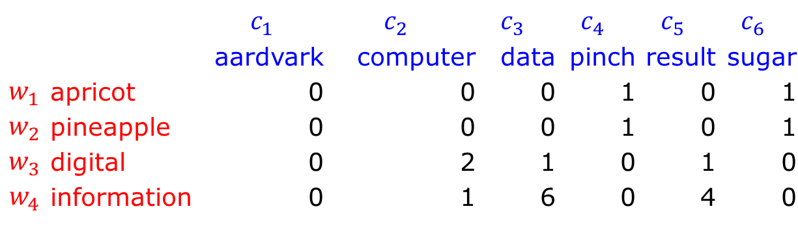
Co-occurrence Relations
 |  | $$c_{1}$$ | $$c_{2}$$ | $$c_{3}$$ | $$c_{4}$$ | $$c_{5}$$ | $$c_{6}$$
 |  | aardvark | computer | data | pinch | result | sugar
$$w_{1}$$ | apricot | 0 | 0 | 0 | 1 | 0 | 1
$$w_{2}$$ | pineapple | 0 | 0 | 0 | 1 | 0 | 1
$$w_{3}$$ | digital | 0 | 2 | 1 | 0 | 1 | 0
$$w_{4}$$ | information | 0 | 1 | 6 | 0 | 4 | 0
First-order co-occurrence relation
Each cell of the explicit representation
Words that appear near each other in the language
E.g. drink to beer or wine
Second-order co-occurrence relation
Cosine similarity between the semantic vectors
Words that appear in similar contexts
E.g. beer to wine, or knowledge to wisdom

Slide 12
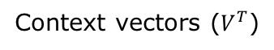
Dense Vectors with SVD
Singular Value Decomposition (SVD) C = UΣV^{T}
Start with an explicit PPMI word-context matrix (usually |V|=|C|)
contexts
|V|✕|C|
|V|✕|C|
|C|✕|C|
|C|✕|C|
words
=
Eigenvalues (Σ)
Context vectors ($V^{T}$)
Word vectors (U)

Slide 13
Dense Vectors with SVD
Keep only top d eigenvalues in Σ and set the rest to zero
The dense word vector representations are the truncated U matrix
contexts
d
d
|V|✕|C|
|V|✕|C|
|C|✕|C|
|C|✕|C|
d
words
=
Eigenvalues (Σ)
Context vectors ($V^{T}$)
Word vectors (U)

Slide 14

word2vec SkipGram
Training Data
Window size of 2
http://mccormickml.com/2016/04/19/word2vec-tutorial-the-skip-gram-model/

Slide 15
Basic Neural Architecture
(fox, quick)
Input Layer
Hidden Layer
Decoding
Output Layer
Encoding
Word: fox
Embedding
Context: quick
Linear activation
Word vectors
Context vectors
Softmax
https://web.stanford.edu/~jurafsky/slp3/

Slide 16
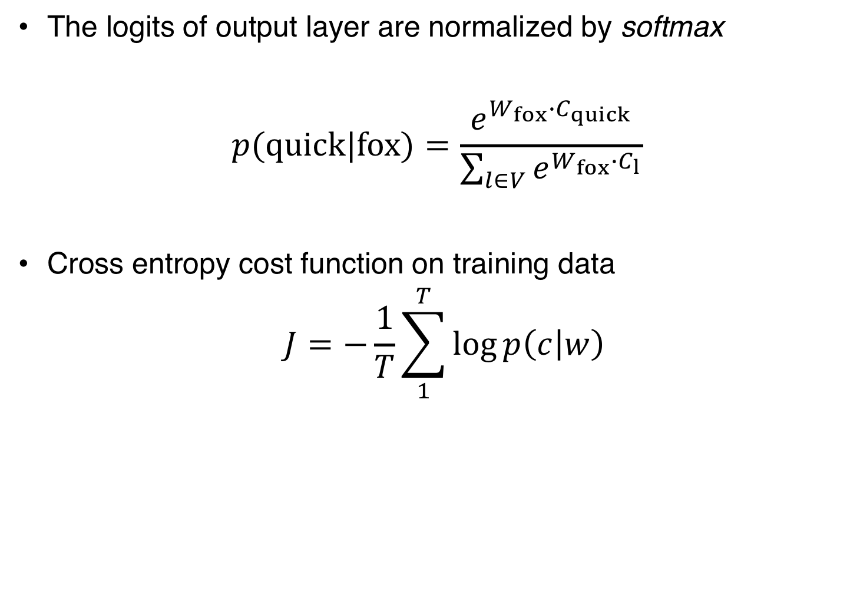
Common Optimization Approach
The logits of output layer are normalized by softmax
$$p(quick|fox)=\frac{e^{W_{fox}∙C_{quick}}}{\sum_{l∈V}{e^{W_{fox}∙C_{l}}}}$$
Cross entropy cost function on training data
$$J=−\frac{1}{T}\sum_{1}^{T}{\log{p\left(c | w\right)}}$$

Slide 17
Tesgüino
Heineken
Word vector

Slide 18
Tesgüino
Heineken
Word vector

Slide 19
Tesgüino
Heineken
Word vector
Context vector

Slide 20
drink
Tesgüino
Heineken
Word vector
Context vector

Slide 21
drink
Tesgüino
Heineken
Word vector
Context vector

Slide 22
drink
Tesgüino
?
Corpus: (Heineken, drink)
Question
How Long Should be the size of the Arrow??
Heineken
Word vector
Context vector

Slide 23
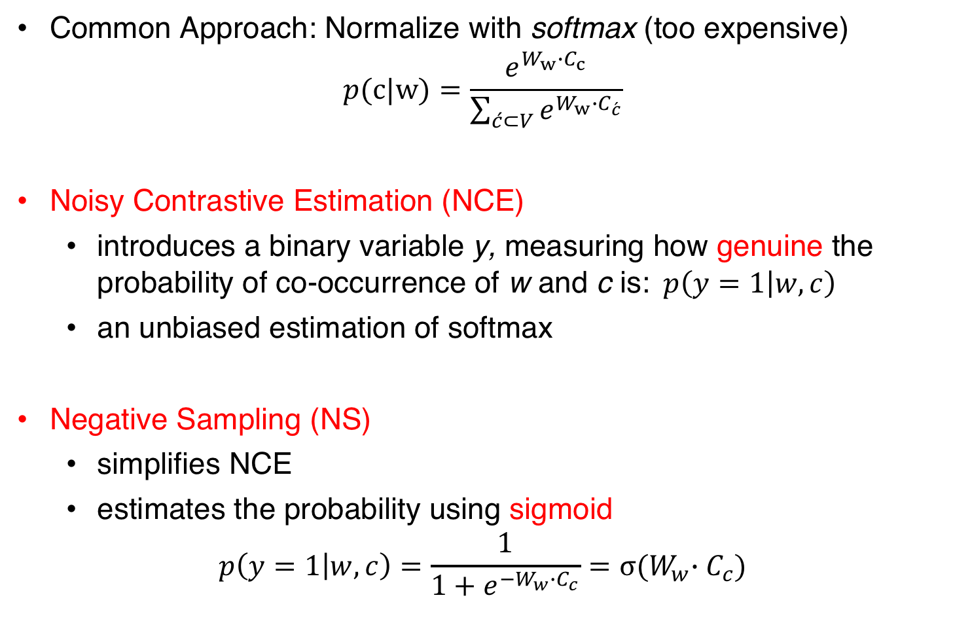
Negative Sampling
Common Approach: Normalize with softmax (too expensive)
$$p(c|w)=\frac{e^{W_{w}∙C_{c}}}{\sum_{\acute{c}⊂V}{e^{W_{w}∙C_{\acute{c}}}}}$$
Noisy Contrastive Estimation (NCE)
introduces a binary variable y, measuring how genuine the probability of co-occurrence of w and c is:$p\left(y=1 | w,c\right)$
an unbiased estimation of softmax
Negative Sampling (NS)
simplifies NCE
estimates the probability using sigmoid
$$p\left(y=1 | w,c\right)=\frac{1}{1+e^{−W_{w}∙C_{c}}}=σ{{(W}_{w}∙C_{c})}$$

Slide 24
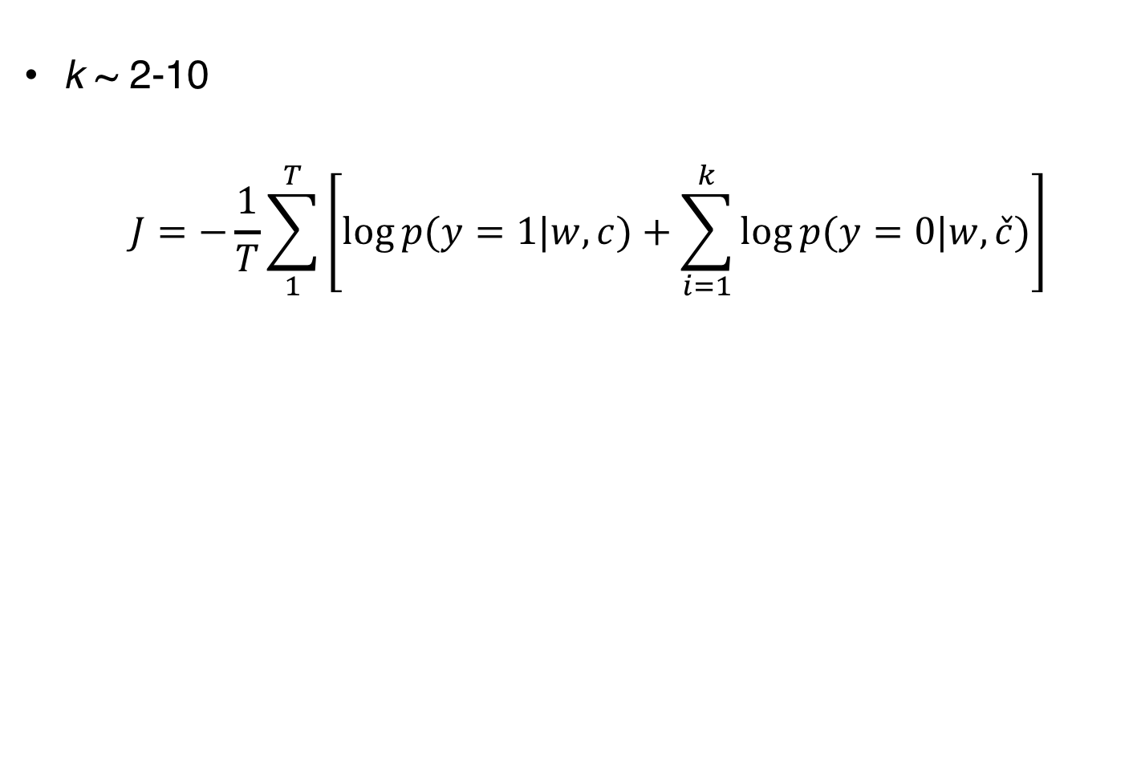
Cost Function of word2vec with Negative Sampling
k ~ 2-10
$$J=−\frac{1}{T}\sum_{1}^{T}{\left[\log{p(y=1|w,c)}+\sum_{i=1}^{k}{\log{p(y=0|w,\check{c})}}\right]}$$
Genuine co-occurrence probability
Randomly sampled probability

Slide 25
drink
Tesgüino
?
Use sigmoid for Pull factor.
Heineken
Word vector
Context vector

Slide 26
drink
Tesgüino
Move! (update vectors)
Select k context words randomly.
Calculate push factors.
Heineken
Word vector
Context vector

Slide 27
Ongoing Work …
Applications in Text Analysis
Financial Volatility Prediction
Gender Bias in Wikipedia
Word Embedding in IR
Generalized Translation Models
Uncertainty in Word Similarity
Threshold on Similarity
Adapting Word Similarity
Fusion of Word Embeddings
Multi-resource Word Representation Learning
Background
Explicit and Dense Word Representation
word2vec SkipGram Model

Slide 28

Query Expansion
Query:
knowledge
Query Expansion
Query:
knowledge insight understanding wisdom
28

Slide 29
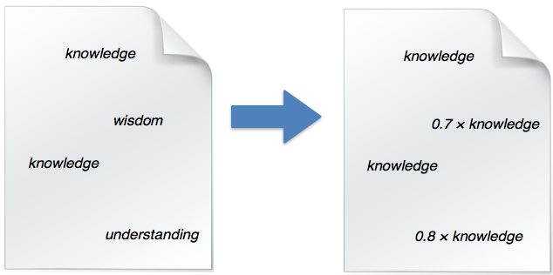
Model Expansion
Generalized Translation Models
Query:
knowledge
Generalizing Translation Models in the Probabilistic Relevance Framework
Navid Rekabsaz, Mihai Lupu, Allan Hanbury, Guido Zuccon
In Proceedings of ACM International Conference on Information and Knowledge Management (CIKM 2016)
29

Slide 30
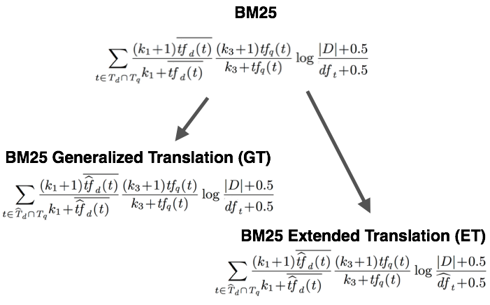

Generalized/Extended Translation Models
30

Slide 31
IR Performance
Gain of MAP over original models, averaged over 6 collections
Stat sign. Test
PL
BM25
BM25VA
LM
MATF
STD vs all
LOG vs GT,ET
NORM vs GT,ET
PRF vs PRF-GT,
PRF-ET
no sign b/w
GT vs PRF-GT
ET vs PRF-EF
Notes:
gain of MAP over original model

Slide 32
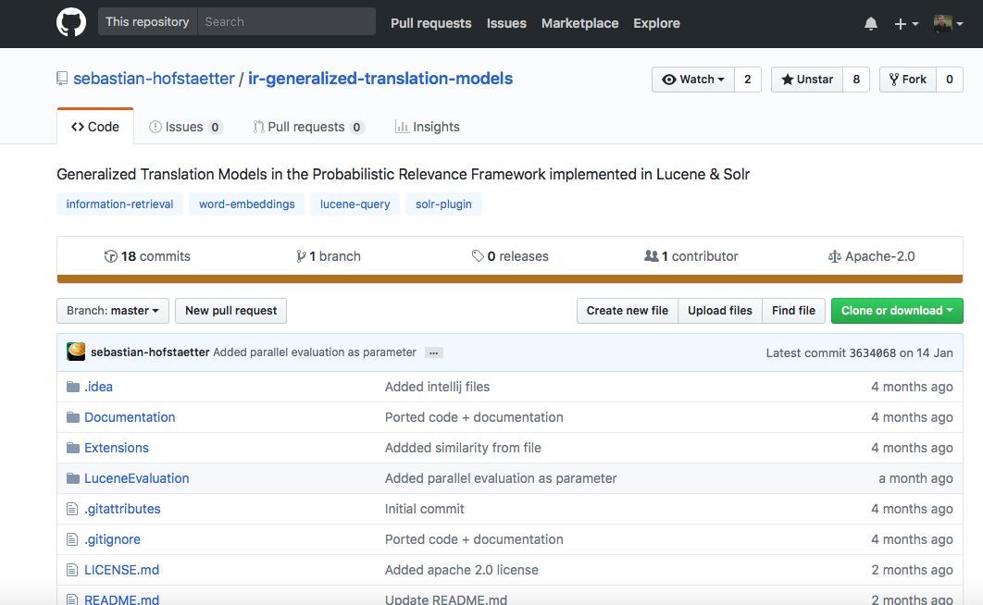
Open Source Implementation
Implemented for Solr and Lucene
https://github.com/sebastian-hofstaetter/ir-generalized-translation-models

Slide 33
Similarity Threshold
book
dwarfish
books | 0.82
foreword | 0.77
author | 0.74
published | 0.73
preface | 0.69
republished | 0.68
reprinted | 0.68
afterword | 0.67
memoir | 0.67
corpulent | 0.44
hideous | 0.43
unintelligent | 0.42
wizened | 0.42
catoblepas | 0.42
creature | 0.42
humanoid | 0.41
grotesquely | 0.41
tomtar | 0.41
Threshold
TopN
Exploration of a Threshold for Similarity based on Uncertainty in Word Embedding.
Navid Rekabsaz, Mihai Lupu, Allan Hanbury, Guido Zuccon
In Proceedings of the European Conference on Information Retrieval Research (ECIR 2017)
Uncertainty in Neural Network Word Embedding: Exploration of Threshold for Similarity.
Navid Rekabsaz, Mihai Lupu, Allan Hanbury
Neu-IR Workshop of the ACM Conference on Research and Development in Information Retrieval (NeuIR-SIGIR 2016)

Slide 34
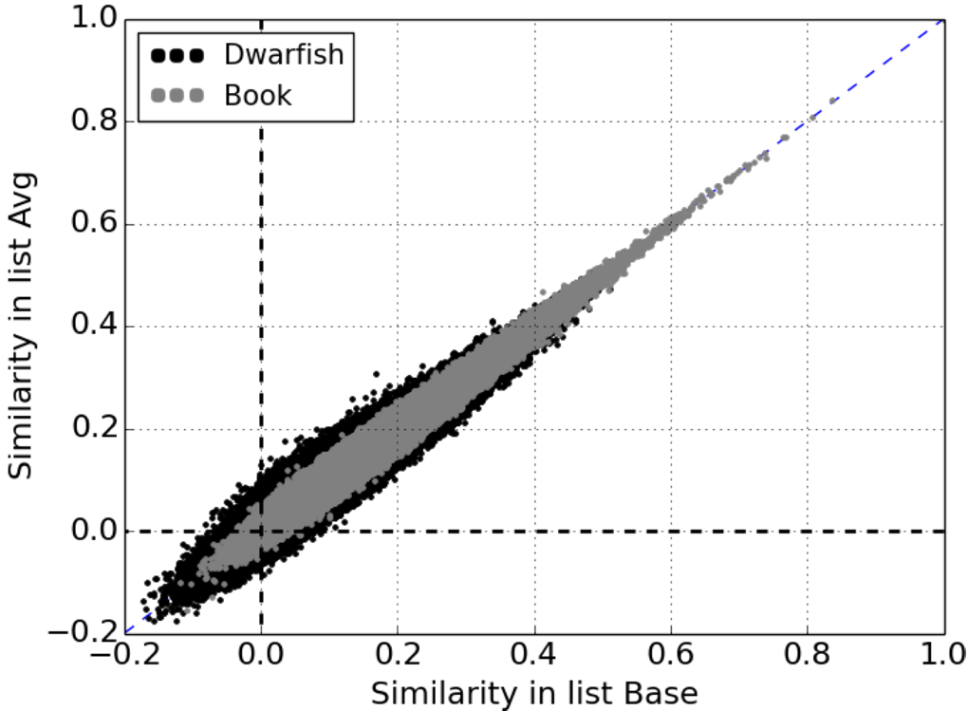
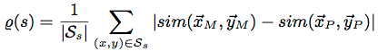
Uncertainty in Similarity
Uncertainty:

Slide 35
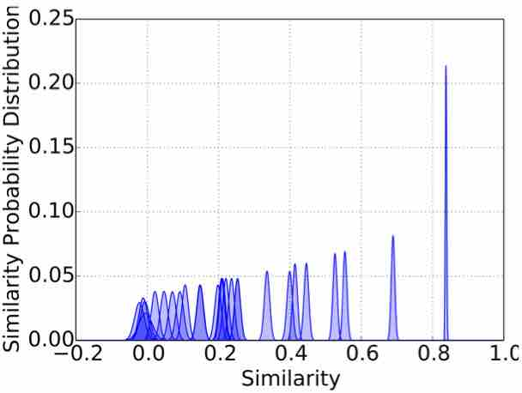
Similarity Probability Distribution
Similarity between terms as probability distribution instead of concrete values

Slide 36
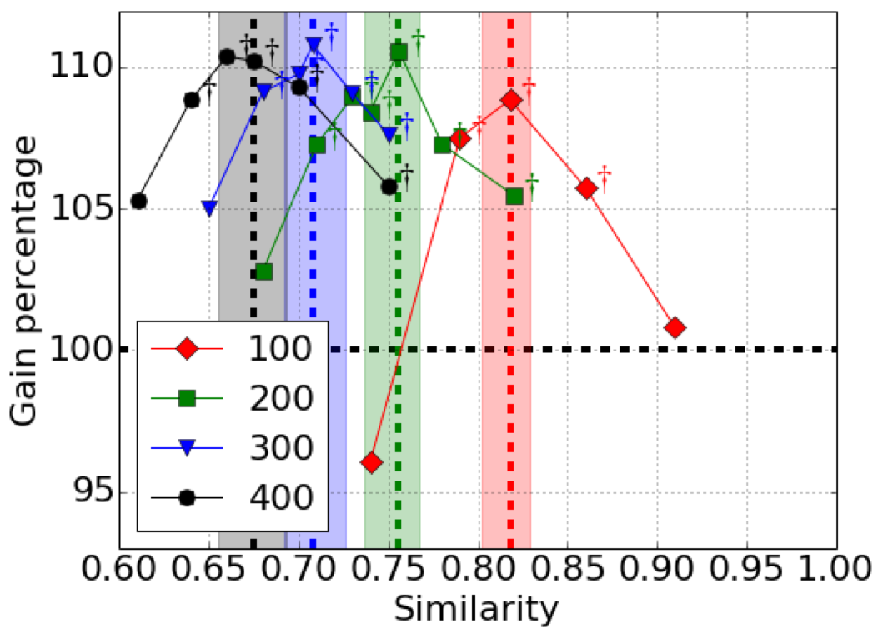
Experiments Results
Gain of MAP over baseline, averaged on four collections.
Optimal threshold is either the same or in the confidence interval of the proposed threshold.

Slide 37
Ongoing Work …
Applications in Text Analysis
Financial Volatility Prediction
Gender Bias in Wikipedia
Word Embedding in IR
Generalized Translation Models
Uncertainty in Word Similarity
Threshold on Similarity
Adapting Word Similarity
Fusion of Word Embeddings
Multi-resource Word Representation Learning
Background
Explicit and Dense Word Representation
word2vec SkipGram Model

Slide 38
word2vec – Topic Shifting
word2vec (window context)
Raising temperature due to the global_warming in Antarctica
Raising temperature due to the climate_change in Antarctica
similar terms, achieved from window-context can cause topic shifting!
Asthma: [Bronchitis, allergy, allergies, Arthritis, Diabetes]

Slide 39
Document Context
Using LSI: word document PPMI matrix + SVD
Words with similar document contexts capture the topical relations
global warming
fossil fuel
similar

Slide 40
Document and Window Context
word2vec
LSI
Asthma
Bronchitis
allergy
allergies
Arthritis
Diabetes
Asthma
symptoms
breathing
airway
disease
allergy
+

Slide 41
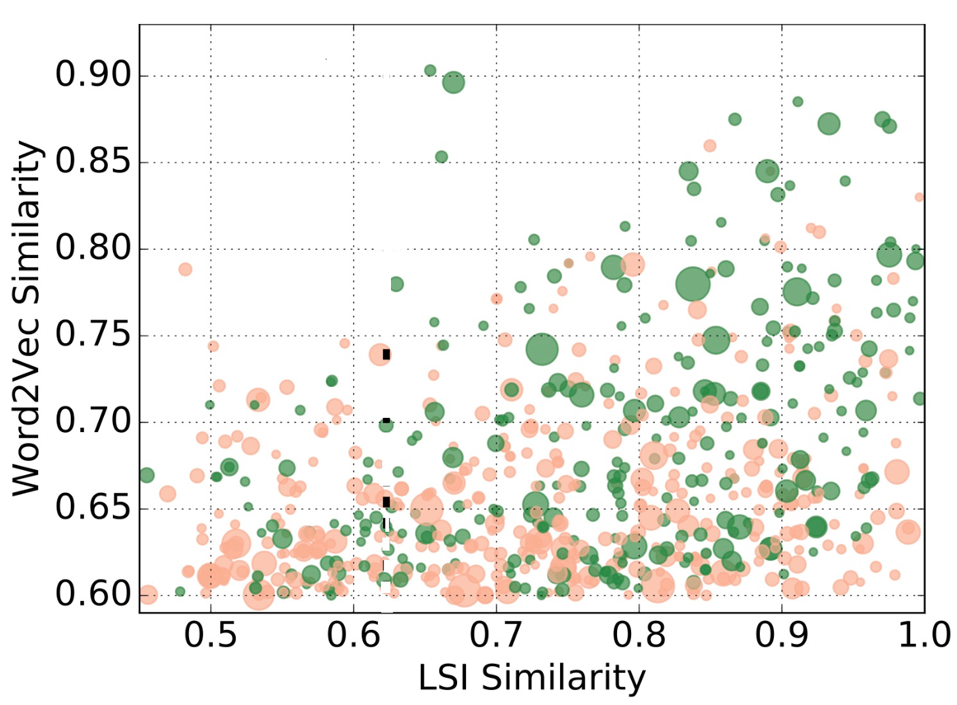
Performance Gain of Terms
Gain of adding each extended term on performance
document context to filter negative terms (Post-Filtering method)
Word Embedding Causes Topic Shifting; Exploit Global Context!
Navid Rekabsaz, Mihai Lupu, Hamed Zamani, Allan Hanbury
Proceedings of the ACM Conference on Research and Development in Information Retrieval (SIGIR 2017)
Notes:
gain of MAP over original model

Slide 42
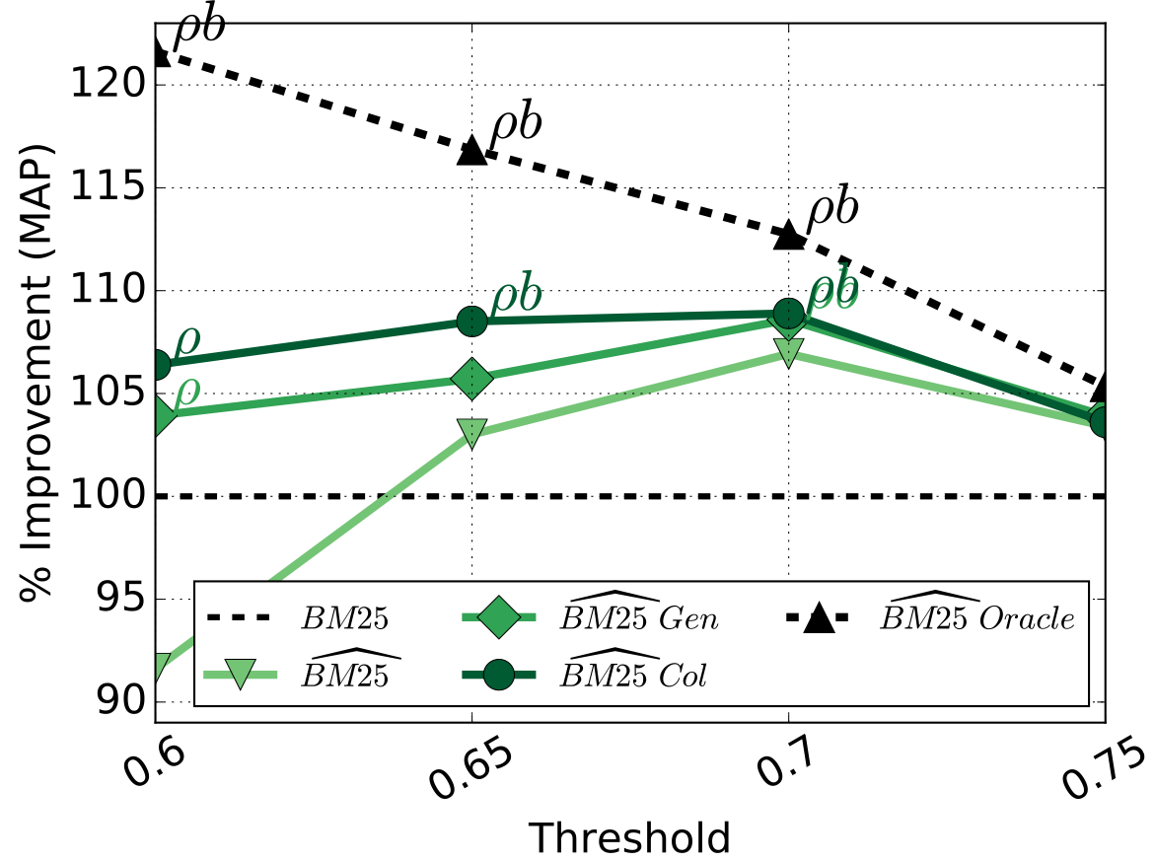
Post-Filter Embedding
Gain of MAP over baseline, averaged on three collections.
Notes:
gain of MAP over original model

Slide 43
Embedding Retrofitting
Incorporating external knowledge (e.g. from WordNet)
Post-processing step on a word embedding model
Manaal Faruqui, et al.
Notes:
gain of MAP over original model

Slide 44
Retrofitting with Document-Context
Retrofitting word2vec with document-context LSI
Highly similar LSI words (threshold@0.82)
Alzheimer
Alzheimer
MS
MS
Multiple sclerosis
Notes:
gain of MAP over original model

Slide 45
Retrofitting Retrieval Results
Patent Domain : CLEF-IP 2013
LSI with Post-Filtering or Retrofitting is effective
Notes:
gain of MAP over original model

Slide 46
Ongoing Work …
Applications in Text Analysis
Financial Volatility Prediction
Gender Bias in Wikipedia
Word Embedding in IR
Generalized Translation Models
Uncertainty in Word Similarity
Threshold on Similarity
Adapting Word Similarity
Fusion of Word Embeddings
Multi-resource Word Representation Learning
Background
Explicit and Dense Word Representation
word2vec SkipGram Model

Slide 47
Volatility in Financial System
return price=(price(t) / price(t-1))-1
volatility=log(std(return prices))
Kogan et al. [2009]
Volatility Prediction using Financial Disclosures Sentiments with Word Embedding-based IR Models
Navid Rekabsaz, Mihai Lupu, Artem Baklanov, Allan Hanbury, Alexander Duer, Linda Anderson
In Proceedings of the Annual Meeting of the Association for Computational Linguistics (ACL 2017)

Slide 48
Companies Annual Reports

Slide 49
Volatility Prediction
Prediction of the upcoming quartiles
Applying Generalized BM25 weighting model as features for ML
Text data significantly improves prediction

Slide 50
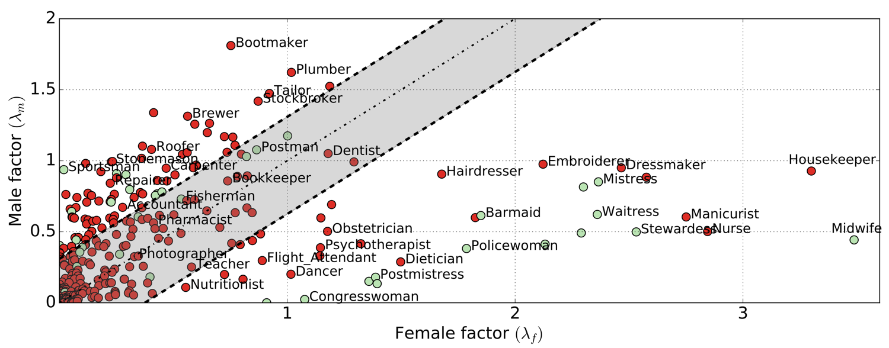
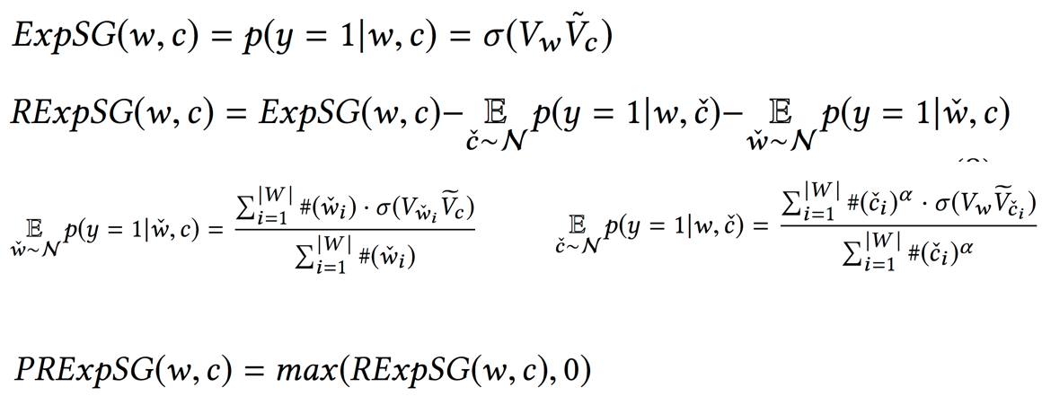
Case Study
Observation on gender bias in Wikipedia using explicit word2vec SkipGram

Slide 51
Ongoing Work …
Applications in Text Analysis
Financial Volatility Prediction
Gender Bias in Wikipedia
Word Embedding in IR
Generalized Translation Models
Uncertainty in Word Similarity
Threshold on Similarity
Adapting Word Similarity
Fusion of Word Embeddings
Multi-resource Word Representation Learning
Background
Explicit and Dense Word Representation
word2vec SkipGram Model

Slide 52
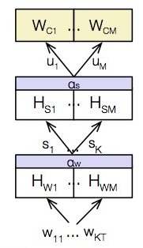
Supervised word embedding for IR
Learning word embedding based on relevance judgments
Deep IR model
Hierarchal Attention-based IR models
Applicable to Cross-Lingual IR, and transfer learning
Multi-Vector Word Embedding
Mixtures of embeddings for every word to disambiguate senses
Multi-Lingual Neural Language Modeling
Generalize language modeling for low-resource languages by jointly learning with several languages
Notes:
gain of MAP over original model

Slide 53
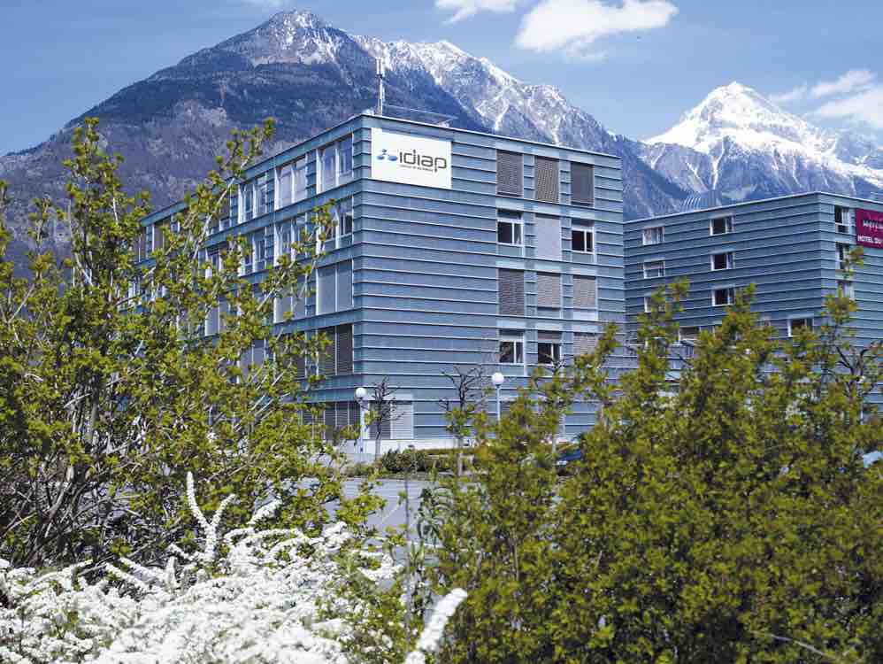
Thanks!
navid.rekabsaz@idiap.ch
@navidrekabsaz

